Slide 1
OSM 419 – Operations Strategy
Asset and Network Flexibility and Consolidation

Slide 2
Different Kinds and Benefits of Flexibility
Asset type: what kind of assets are best?
Flexibility: “the ability to adapt or change”
  Scope flexibility: breadth of activities
  Agility: speed at which an asset/network/organization change
  Dynaco USA – rationalized flexibility
  Toyota Motor Co. – modular car designs, platform sharing, flexible capacity

Slide 3
Flexible vs. Specialized Assets
Specialized/Dedicated Assets
Generalists/General-purpose Equipment
Flexible assets
  Cross-trained employees

Slide 4
Scope/Mix Flexibility
Scope/Mix Flexibility: breadth of activities that an asset can perform.
Economies of scope: incremental value obtained from sharing assets over several markets/products.
Mix flexibility is especially beneficial for organizations where the aggregate category volume is fairly stable, but customer choice within the category hard to predict.

Slide 5
Scale/Volume Flexibility
Scale/Volume Flexibility: the degree to which a resource can change its processing rate or production volume.
Scale flexibility is especially important for organizations that face high seasonality or uncertainty in demand volume.

Slide 6

Agility and New Product Flexibility
Agility
  Quick changeovers, postponement
New Product Flexibility: measures the ability to introduce new products into the operating system (affecting sourcing, production and distribution)
  Nike FuelBand – switch from apparel-focused supply chain to a consumer electronics supply chain.

Slide 7
Robustness
Robustness: performance (e.g. cost, quality, responsiveness) does not vary much over the range of activities performed.
Each resource has at least one activity that maximizes its performance.
If deviating from that preferred activity decreases performance, then the resource is inflexible.

Slide 8
Automation impacts Flexibility
Automation: the degree to which a process can operate without human supervision.
Manual processes typically utilize some capital equipment, but their operation also requires human presence.
  Most service processes such as restaurants
Fully automated processes without human supervision.
  Glass manufacturing plants must operate continuously to prevent molten glass from solidifying

Slide 9
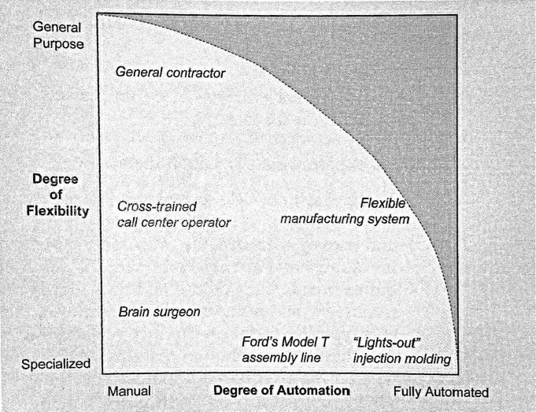
Degree of Automation vs.
Degree of Flexibility

Slide 10
Alignment with Capabilities
Agile manual process – agile worker based production are systems with cross-trained operators and equipment whose operation requires constant human presence.
Automation can provide higher consistency (quality), volumes or lower costs.
Increased automation typically comes with increased rigidity leading to a trade-off

Slide 11
Obstacles to Achieving Flexibility
Flexibility is expensive and difficult to value
Flexibility is not used appropriately
Flexibility is not well understood
Complexity, competition, and customer perception

Slide 12
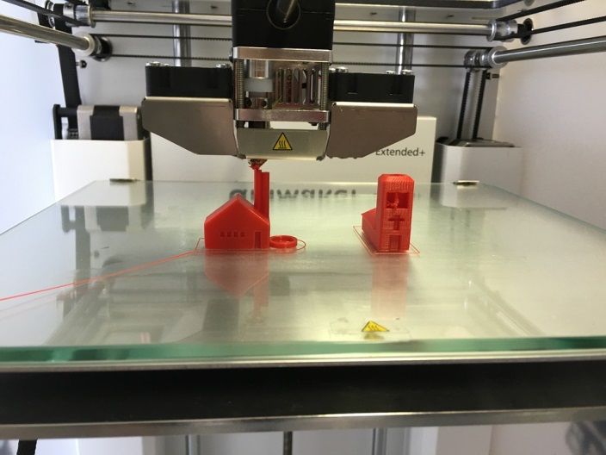
Asset Flexibility: Valuation and Consolidation
3-D printer for additive manufacturing
1) scale economies (aggregating volumes)
2) risk pooling (aggregating volatilities)
3) allocation flexibility and information updating

Slide 13
Network Flexibility
Dedicated network
Asset flexibility = resource sharing
Resource substitution
Hybrid networks
Transshipment
Postponed differentiation and late customization

Slide 14
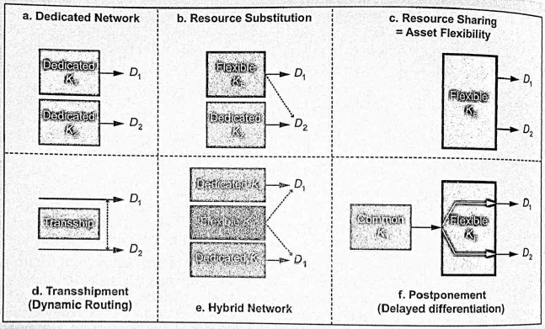
Network Flexibility

Slide 15
Tailored Network Flexibility
Dedicated and flexible assets
Resource pooling and chained routing
Tailored mix flexibility
Tailored component commonality

Slide 16
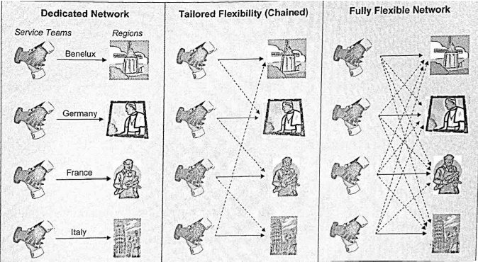
Tailored Network Flexibility

Slide 17
Product Design Strategies for Flexibility
Standard or universal design
Component commonality and platform sharing
Modular design
Complexity : design structure matrix
  Complexity = (sum of all elements) X (sum of all interactions)
The downside of modular design is the benefit of integral design
Adaptable design

Slide 18
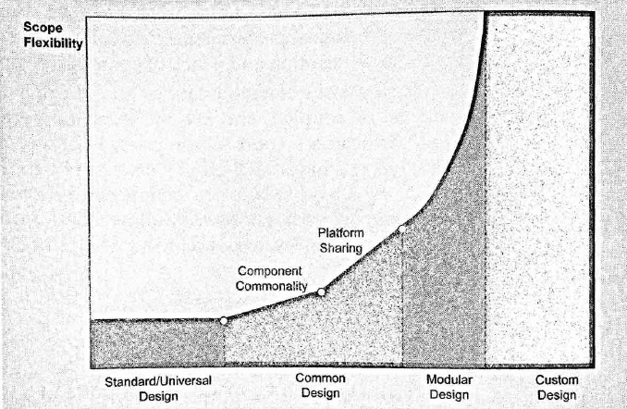
Product Design Strategies

Slide 19
Mass Customization
Compromise between mass production and full custom work.
Balance the demand benefits of customization with the supply efficiencies of standardization by limiting customer choice to a pre-set range while increasing the flexibility of a flow process

Slide 20
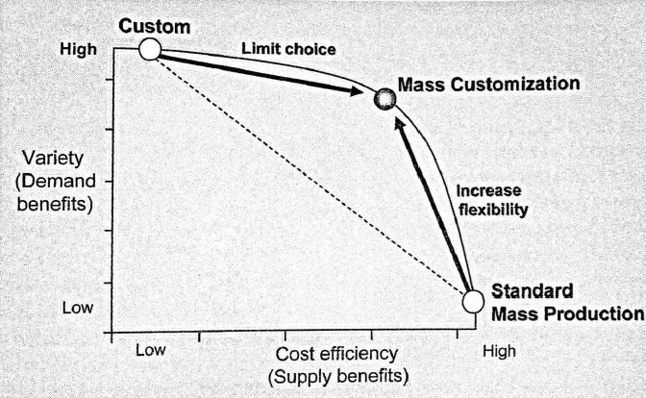
Mass Customization

Slide 21
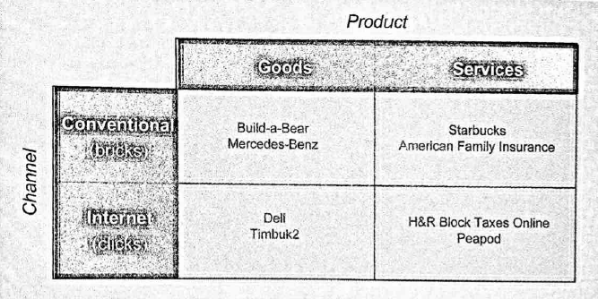
Mass Customization
Product and Channels

Slide 22
Guidelines for Capacity Flexibility
A little flexibility goes a long way when used smartly
Reduce the cost of flexibility using adaptable capacity and setup time reduction
Determine the required level of flexibility
Integrate flexibility strategy with new product strategy
Be clear on the role of flexibility

